Slide 1
Azure Community Conference 2021

Slide 2

Vinodh Kumar TD

Slide 3
Data warehousing in azure synapse analytics

Slide 4

Microsoft MCT C# Corner MVP Data Blogger --> vinsdata.wordpress.com MS community champion
Azure Data Architect

Slide 5
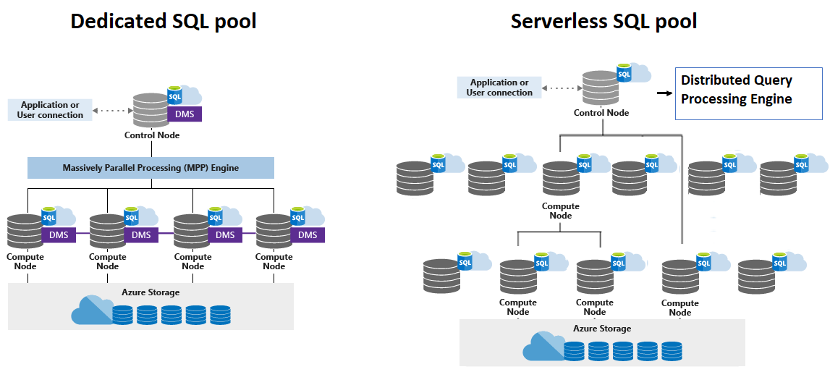
Synapse SQL
Dedicated SQL Pool
Serverless SQL Pool
Spark Pool
Synapse Pipelines
Synapse Studio

Slide 6
Use case
Exploratory data analysis (EDA) is used by data scientists to analyze and investigate data sets and summarize their main characteristics, often employing data visualization methods. It helps determine how best to manipulate data sources to get the answers you need, making it easier for data scientists to discover patterns, spot anomalies, test a hypothesis, or check assumptions.
EDA is primarily used to see what data can reveal beyond the formal modeling or hypothesis testing task and provides a provides a better understanding of data set variables and the relationships between them. It can also help determine if the statistical techniques you are considering for data analysis are appropriate.
Traditional Method which can take weeks or months
Requirements gathering. Document what to do with the data.
Data modeling. Determine how to model the numeric and attribute data into fact and dimension tables. Traditionally, you do this step before you acquire the new data.
ETL. Acquire the data and massage it into the data warehouse's data model

Slide 7
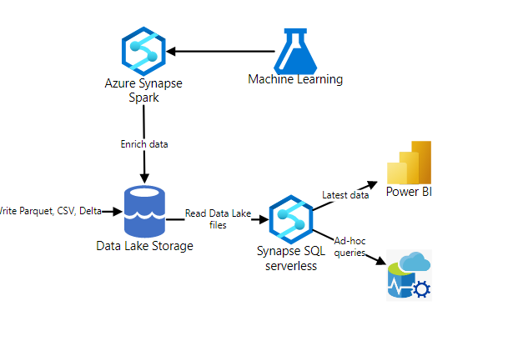
With Azure Synapse analytics you can focuses first on generating business insights and then turns to solving the modeling and ETL tasks, by directly querying the raw files from the lake

Slide 8
Query Parquet files using serverless SQL pool
- reading parquet file
select top 10 *
from openrowset(
bulk 'https://pandemicdatalake.blob.core.windows.net/public/curated/covid-19/ecdc_cases/latest/ecdc_cases.parquet',
format = 'parquet') as rows

Slide 9
You can create an external data source with the location that points to the root folder of the storage and use that data source and the relative path to the file in OPENROWSET function.
create external data source covid
with ( location = 'https://pandemicdatalake.blob.core.windows.net/public/curated/covid-19/ecdc_cases' );
go
select top 10 *
from openrowset(
bulk 'latest/ecdc_cases.parquet',
data_source = 'covid',
format = 'parquet'
) as rows

Slide 10
Analyze data in dedicated sql pool
IF NOT EXISTS (SELECT * FROM sys.objects O JOIN sys.schemas S ON O.schema_id = S.schema_id WHERE O.NAME = 'NYCTaxiTripSmall' AND O.TYPE = 'U' AND S.NAME = 'dbo')
CREATE TABLE dbo.NYCTaxiTripSmall
(
[DateID] int,
[MedallionID] int,
[HackneyLicenseID] int,
[PickupTimeID] int,
[DropoffTimeID] int,
[PickupGeographyID] int,
[DropoffGeographyID] int,
[PickupLatitude] float,
[PickupLongitude] float,
[PickupLatLong] nvarchar(4000),
[DropoffLatitude] float,
[DropoffLongitude] float,
[DropoffLatLong] nvarchar(4000),
[PassengerCount] int,
[TripDurationSeconds] int,
[TripDistanceMiles] float,
[PaymentType] nvarchar(4000),
[FareAmount] numeric(19,4),
[SurchargeAmount] numeric(19,4),
[TaxAmount] numeric(19,4),
[TipAmount] numeric(19,4),
[TollsAmount] numeric(19,4),
[TotalAmount] numeric(19,4)
)
WITH
(
DISTRIBUTION = ROUND_ROBIN,
CLUSTERED COLUMNSTORE INDEX
-- HEAP
)
GO

Slide 11
COPY INTO dbo.NYCTaxiTripSmall
(DateID 1, MedallionID 2, HackneyLicenseID 3, PickupTimeID 4, DropoffTimeID 5,
PickupGeographyID 6, DropoffGeographyID 7, PickupLatitude 8, PickupLongitude 9,
PickupLatLong 10, DropoffLatitude 11, DropoffLongitude 12, DropoffLatLong 13,
PassengerCount 14, TripDurationSeconds 15, TripDistanceMiles 16, PaymentType 17,
FareAmount 18, SurchargeAmount 19, TaxAmount 20, TipAmount 21, TollsAmount 22,
TotalAmount 23)
FROM 'https://contosolake.dfs.core.windows.net/users/NYCTripSmall.parquet'
WITH
(
FILE_TYPE = 'PARQUET'
,MAXERRORS = 0
,IDENTITY_INSERT = 'OFF'
)

Slide 12
Workload management
The dynamic resource classes are implemented with these pre-defined database roles:
smallrc
mediumrc
largerc
xlargerc
The memory allocation for each resource class is as follows.
Service Level | smallrc | mediumrc | largerc | xlargerc
DW100c | 25% | 25% | 25% | 70%
DW200c | 12.5% | 12.5% | 22% | 70%
DW300c | 8% | 10% | 22% | 70%
DW400c | 6.25% | 10% | 22% | 70%
DW500c | 5% | 10% | 22% | 70%
DW1000c to DW30000c | 3% | 10% | 22% | 70%

Slide 13
Q & A

Slide 14
Feedback

Slide 15
THANK YOU!

Slide 17
NAME
DESIGNATION

Slide 18
Presentation Title

Slide 19
Title

Slide 20
Demo Title

Slide 21
Q & A

Slide 22
Feedback

Slide 23
THANK YOU!

